Slide 1
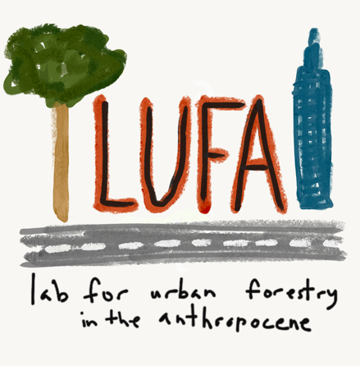
Meeting Critical Human Needs within our Community
Forestry Capabilities or, How can we think about sustainability and urban forests in the context of ecological limits and human social needs?
September 26, 2023
Penn State Extension
Urban Forestry Webinar
Dr. Jess Vogt
Associate Professor, Environmental Science & Studies
Lab for Urban Forestry in the Anthropocene
DePaul University, Chicago, IL
www.lufa-depaul.org

Slide 2
Creative Commons
Attribution-NonCommercial CC BY-NC 4.0
Please feel free to use versions of these slides for your own, non-commercial purposes as long as you cite this original presentation:
Vogt J (2023) Meeting Critical Human Needs within our Community Forestry Capabilities, September 26 , 2023, Penn State Extension Urban Forestry Webinar [virtual presentation]
Feel free to contact me with any questions about usage and credit.
Attribution-NonCommercial CC BY-NC 4.0 This license lets others remix, adapt, and build upon your work non-commercially, and although their new works must also acknowledge you and be non-commercial, they don’t have to license their derivative works on the same terms. https://creativecommons.org/licenses/by-nc/4.0/

Slide 3
4 million years to get to
1 billion people
Data from Steffen et al. (2015a)

Slide 4
In 12 years from 1999-2011, population grew 6 to 7 billion people
Data from Steffen et al. (2015a)

Slide 5
We’ve added another billion since 2011:
Global pop. 8.062+ billion as of Sept 2023
https://www.worldometers.info
Data from Steffen et al. (2015a)

Slide 6
Primary energy use today is more than
30 times what it was in 1750
Data from Steffen et al. (2015a)

Slide 7
Water use has increased by a factor of 6 in the last century alone
Data from Steffen et al. (2015a)

Slide 8
Paper use today is 500% of use in 1961
Data from Steffen et al. (2015a)

Slide 9
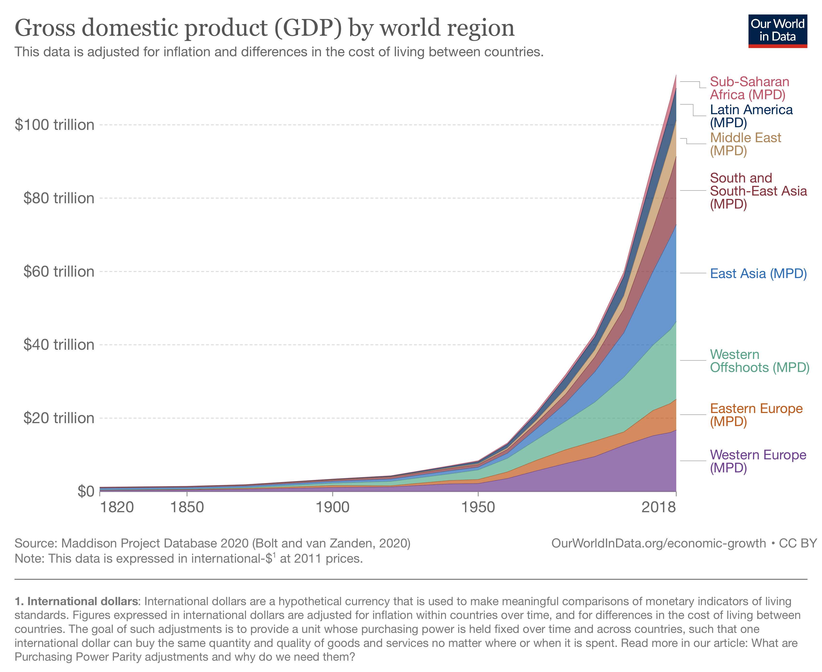
GDP has increased 100-fold between 1820 and 2018

Slide 10
Tropical forest loss has accelerated
…also increases
CO₂ emissions
Data from Steffen et al. (2015a)

Slide 11
Carbon dioxide in atmosphere far exceeds natural levels
…from burning
fossil fuels
Data from Steffen et al. (2015a)

Slide 12
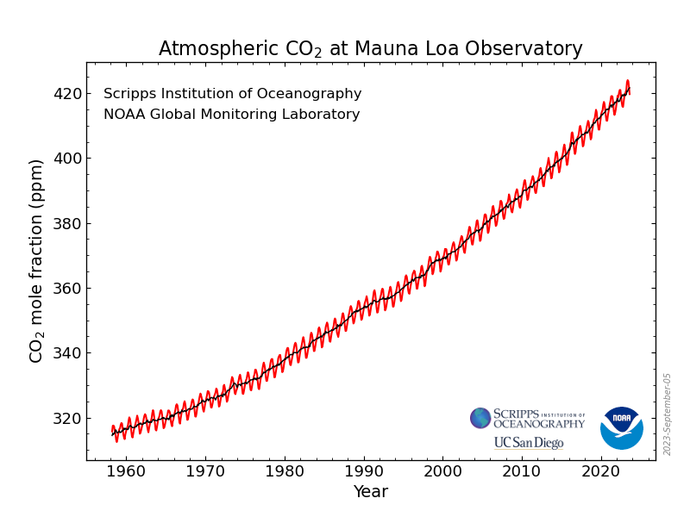
Carbon dioxide in atmosphere far exceeds natural levels
419 ppm
9/29/23
Summer high was 424
…from burning
fossil fuels
https://gml.noaa.gov/ccgg/trends/
Data from Steffen et al. (2015a)

Slide 13
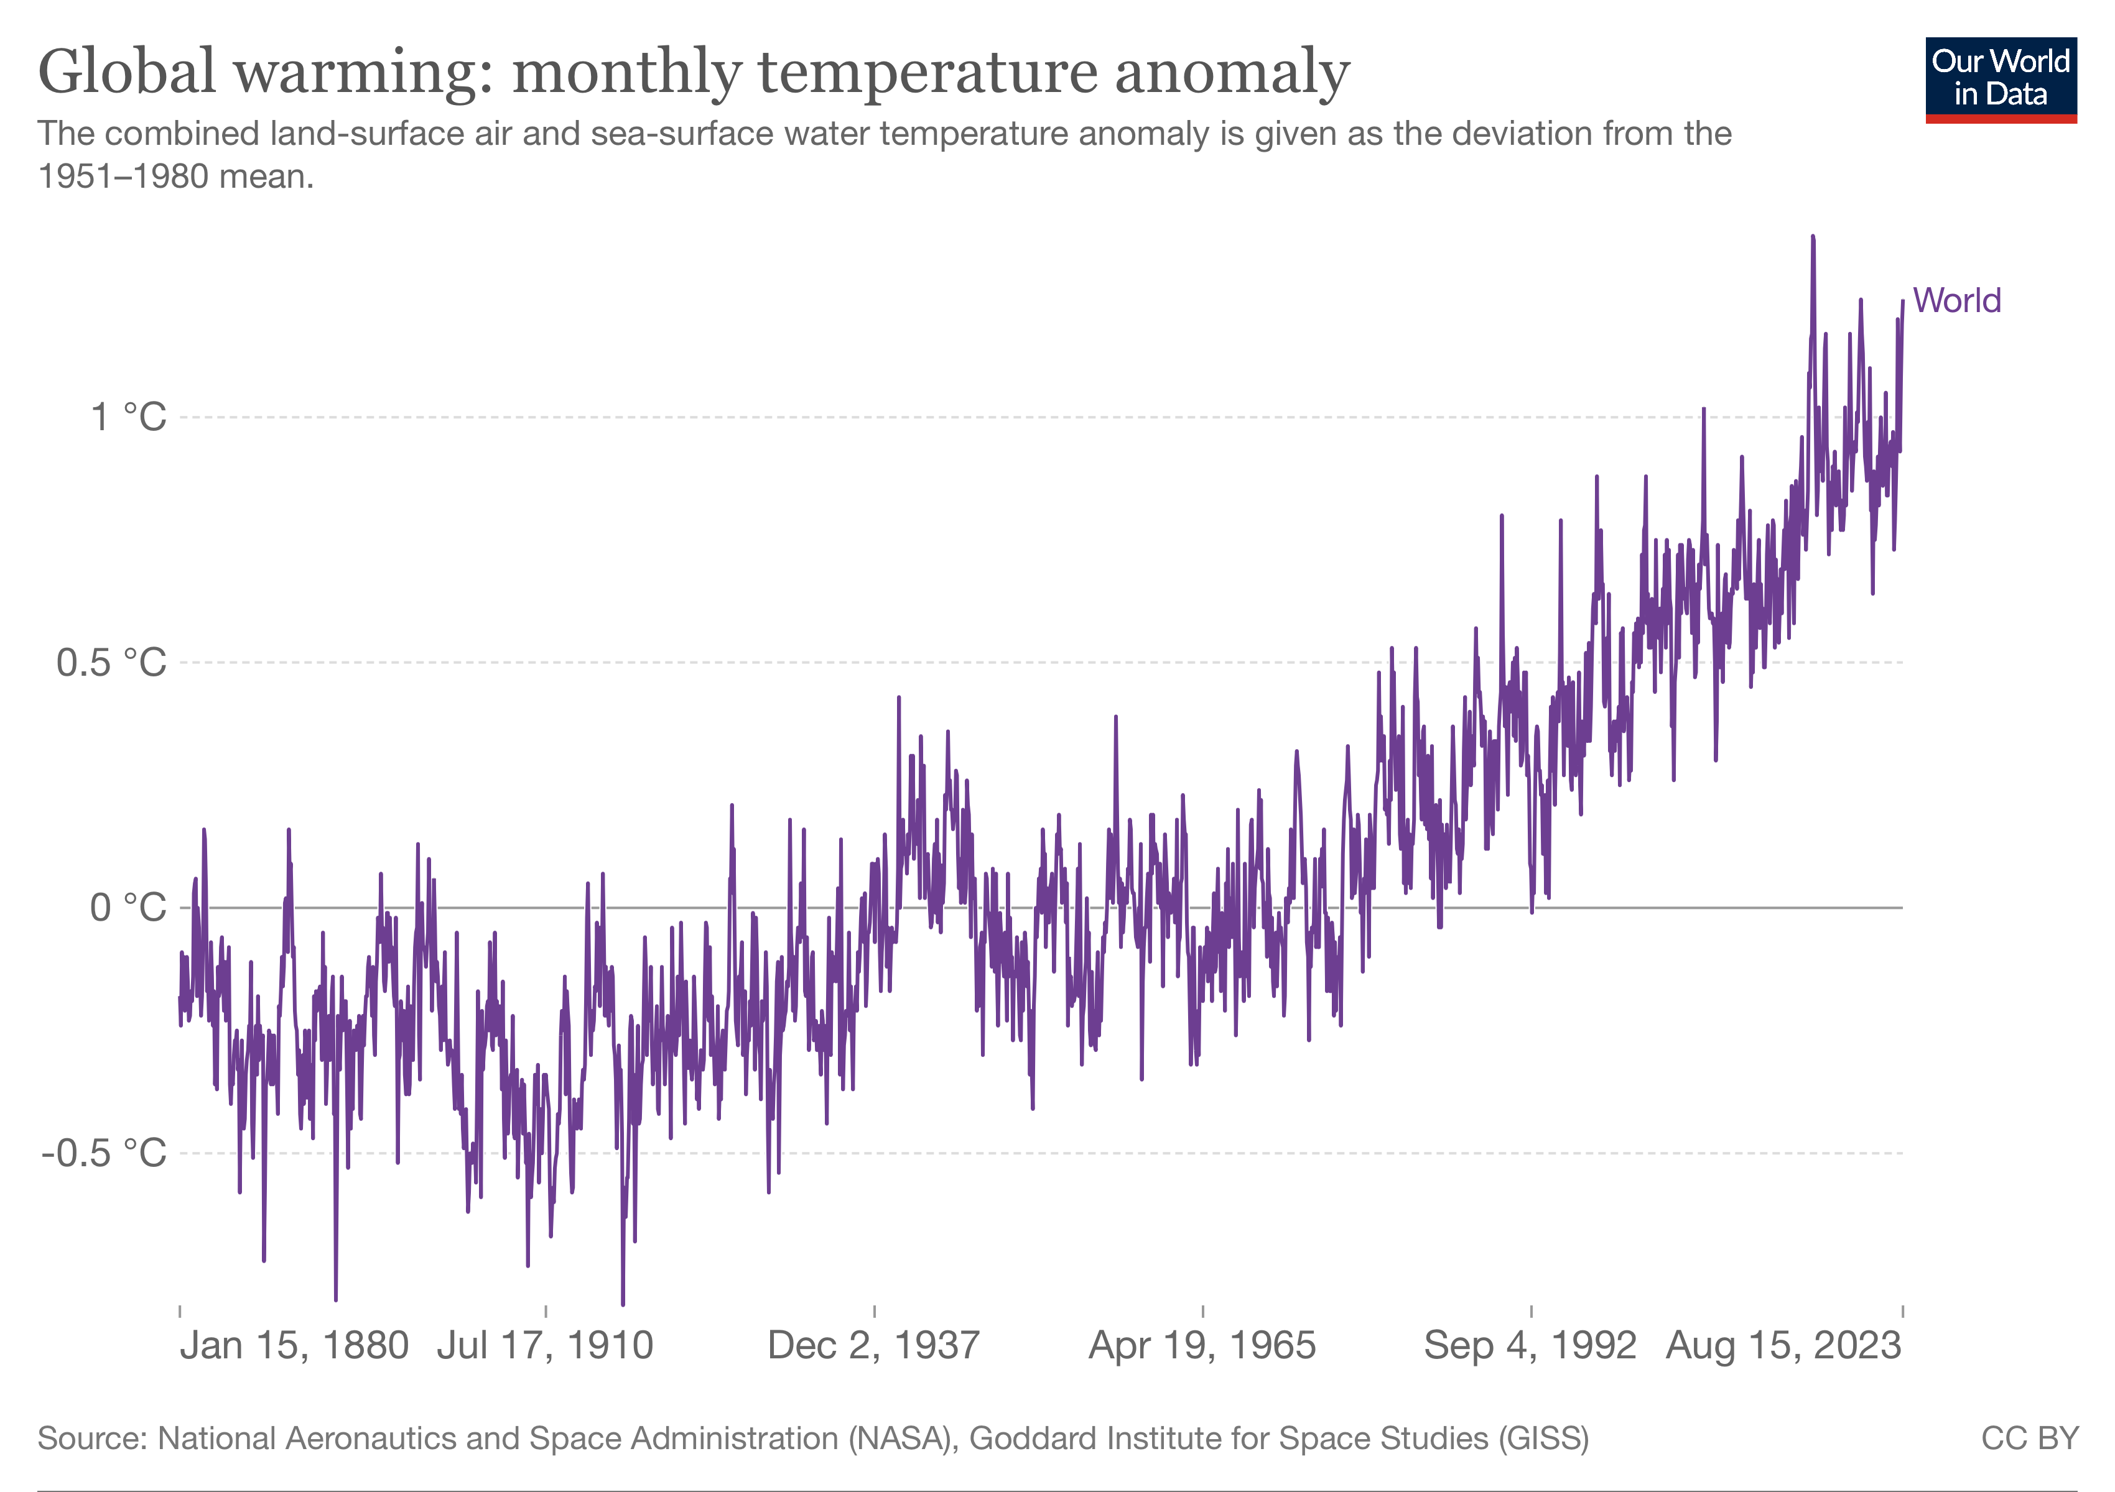
Temperatures have risen with carbon dioxide over the last century
…from burning
fossil fuels

Slide 14
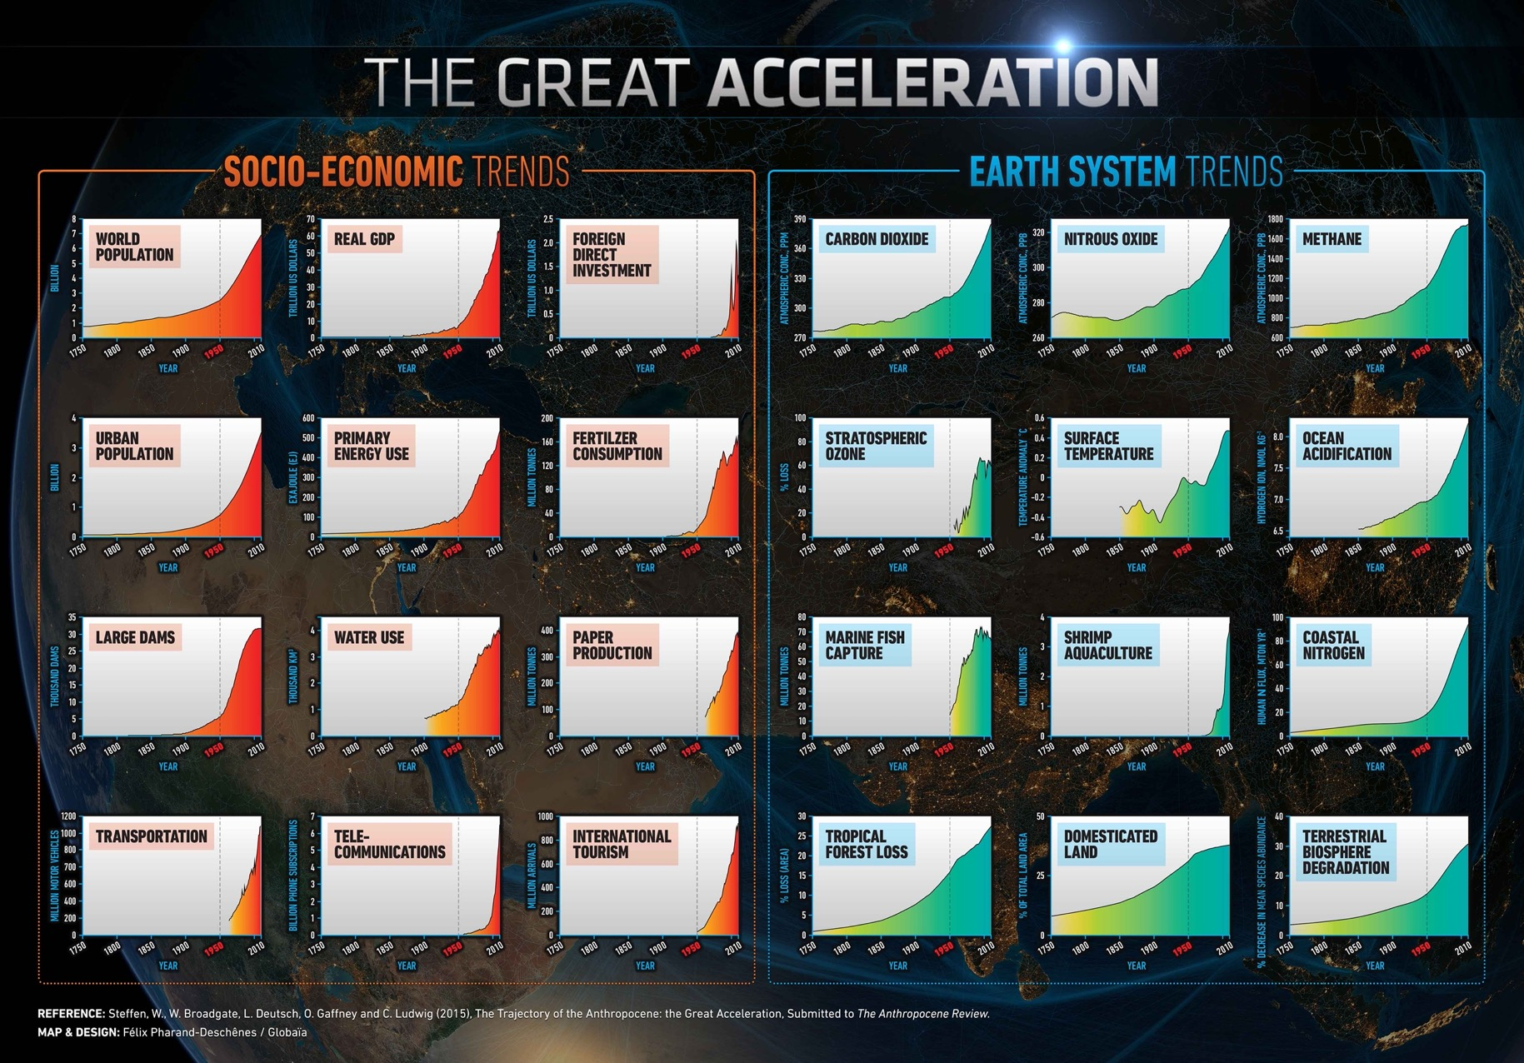
www.anthropocene.info

Slide 15
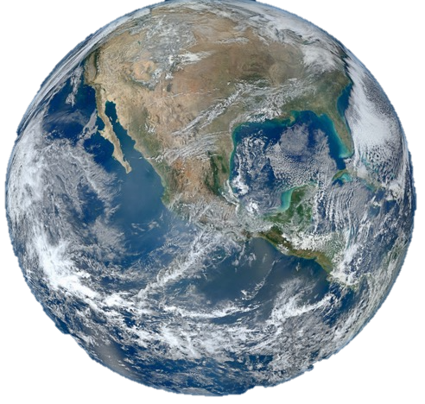
One
Planet Earth
Image credit: NASA

Slide 16

Entering The Anthropocene…
A new geological epoch
Humans are the dominant force on planet
Characterized by dramatically increased and increasing…
Human use of materials & natural resources
Expulsion of waste/pollutants into environment

Slide 17
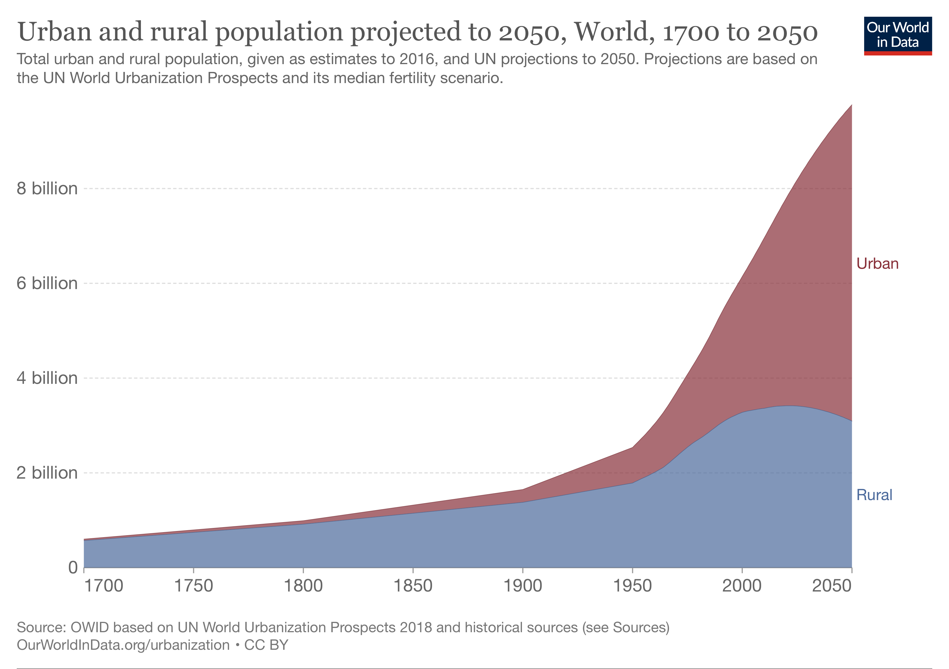

The Anthropocene is happening in urban areas
…80% urban in
industrialized
nations

Slide 18
just
resilient
ecological
economical
sustainable
inclusive

Slide 19


Rest of TODAY’s talk…
Sustainability & Resilience concepts
Examples of how urban forestry can contribute to sustainability and resilience
Framework: “Doughnut model” of sustainability
Take Home Message: Think about how you and your urban forest can operate within environmental constraints while helping meet human needs

Slide 20
What is Sustainability?
Sustainability is trying to meet the challenges of the Anthropocene
Climate change
Limited natural resources (e.g., water)
Increasingly urban populations
New pests, diseases
…and more...

Slide 21
What is Sustainability?
People, Planet, Profit
Planet
People
Profit
<< OLD WAY OF THINKING!
Sustainability here??

Slide 22
What is Sustainability?
People, Planet, Profit
“3 Es” - Environment, Equity, Economy
>> (STILL) OLD WAY OF THINKING!
Planet
People
Profit
Equity
Environment
Sustainability here??
Economy
Sustainability here??

Slide 23
What is Sustainability?
What does “environment” include?
What does “equity” really mean?
And why do we care about the “economy” so much?
“3 Es” - Environment, Equity, Economy
Equity
Environment
Economy
Sustainability here??

Slide 24
A more comprehensive way of thinking about sustainability…
Meeting human needs without exceeding Earth’s ecological limits.
A “safe and just operating space”

Slide 25

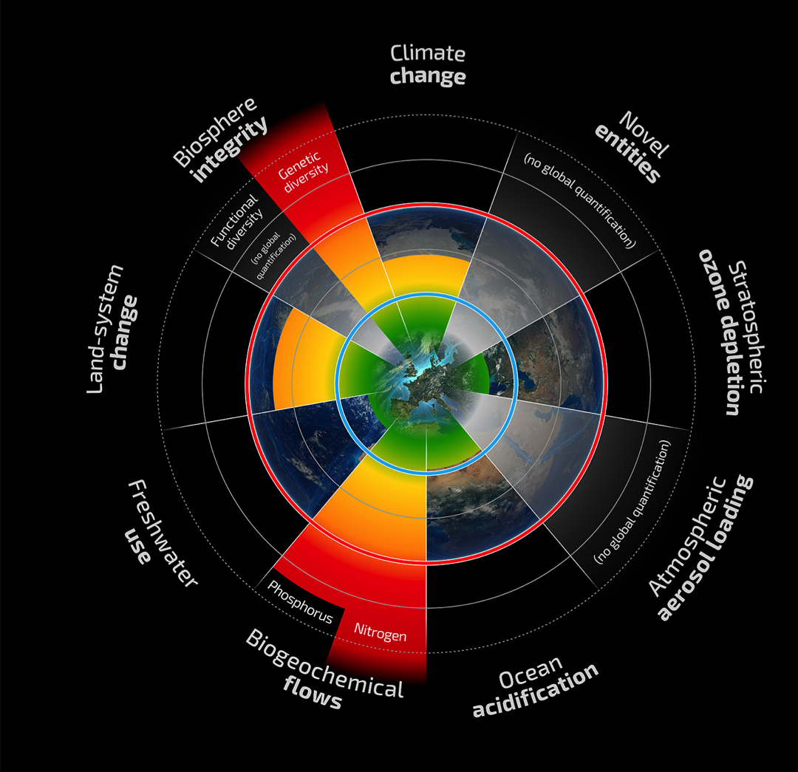
9 planetary boundaries define “safe operating space” for humans in the Anthropocene
Source: Steffen et al. Science 16 Jan 2015
http://www.stockholmresilience.org/21/research/research-news/1-15-2015-planetary-boundaries-2.0---new-and-improved.html
Notes:
A framework we can use to help dissect sustainability ideas is planetary boundaries…

Slide 26
Safe Operating Space
Threshold
Zone of Uncertainty
Boundary

Slide 27
This planetary boundaries definition of sustainability as a “safe operating space” is rooted in resilience.
Arrows represent disturbances
Longer arrow = larger disturbance
Less
resilient space
“Safe space”
Total loss of resilience
Threshold
#1
Threshold
#2

Slide 28
“Hothouse Earth”
Steffen et al. (2018). PNAS 115(33):8252-9. https://doi.org/10.1073/pnas.1810141115
Notes:
Figure from Steffen et al. 2018. Caption below.
Fig. 1.A schematic illustration of possible future pathways of the climate against the background of the typical glacial–interglacial cycles (Lower Left). The interglacial state of the Earth System is at the top of the glacial–interglacial cycle, while the glacial state is at the bottom. Sea level follows temperature change relatively slowly through thermal expansion and the melting of glaciers and ice caps. The horizontal line in the middle of the figure represents the preindustrial temperature level, and the current position of the Earth System is shown by the small sphere on the red line close to the divergence between the Stabilized Earth and Hothouse Earth pathways. The proposed planetary threshold at ∼2 °C above the preindustrial level is also shown. The letters along the Stabilized Earth/Hothouse Earth pathways represent four time periods in Earth’s recent past that may give insights into positions along these pathways (SI Appendix): A, Mid-Holocene; B, Eemian; C, Mid-Pliocene; and D, Mid-Miocene. Their positions on the pathway are approximate only. Their temperature ranges relative to preindustrial are given in SI Appendix, Table S1.

Slide 29
Planetary Boundaries applies resilient logic to 9 key Earth processes to generate “safe operating space” for humans
Source: Steffen et al. Science 16 Jan 2015
http://www.stockholmresilience.org/21/research/research-news/1-15-2015-planetary-boundaries-2.0---new-and-improved.html
Notes:
A framework we can use to help dissect sustainability ideas is planetary boundaries…

Slide 30
What do planetary boundaries, sustainability, & resilience have to do with urban forests??

Slide 31
What is a
“sustainable” urban forest?
“The naturally occurring and planted trees in cities which are managed to provide the inhabitants with a continuing level of economic, social, environmental and ecological benefits today and into the future.”
Clark et al. (1997)
J.R. Clark, N.P. Matheny, G. Cross and V. Wake. (1997). A Model of Urban Forest Sustainability. Journal of Arboriculture 23(1):17-30

Slide 32
Sustainable urban forest
Forest Resource
“sustainable urban forests require a healthy tree and forest resource, community-wide support and a comprehensive management approach” (Clark et al. 1997)
Community
Support
Management
J.R. Clark, N.P. Matheny, G. Cross and V. Wake. (1997). A Model of Urban Forest Sustainability. Journal of Arboriculture 23(1):17-30

Slide 33
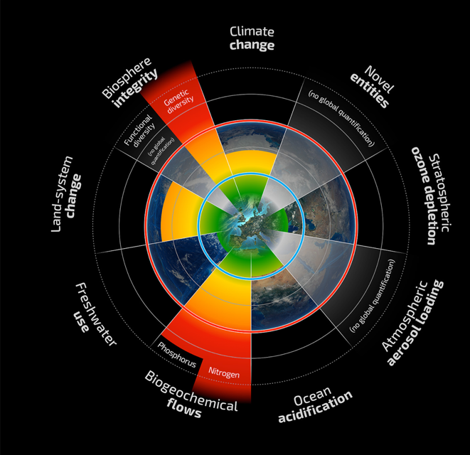




Urban forests and urban forestry are impacted by planetary processes like climate change and land use change…
…but also urban forests can help cities stay within the planetary boundaries.

Slide 34
EX. #1: Climate Change
Lasting changes in weather patterns, including
  Temperature increases
  Increased intensity of storms
  Prolonged periods of drought book-ended by heavy rainfall events
Climate change → Urban forests
Urban forests → Climate change
Notes:
(Worksheet introduction)

Slide 35
Ex. #1: climate Change
Source: Vogt, unpublished manuscript

Slide 36
EX. #1: Climate Change
Lasting changes in weather patterns, including
  Temperature increases
  Increased intensity of storms
  Prolonged periods of drought book-ended by heavy rainfall events
Climate change → Urban forests
Urban forests → Climate change
Ex. management response to climate change:
Avoiding planting in spring or extra summer watering, due to prolonged summer droughts
Ex. urban forests moderate local climate impacts:
Trees provide shade, reduce urban heat island effect, making cities more livable despite incr. temp.
Notes:
(Worksheet introduction)

Slide 37
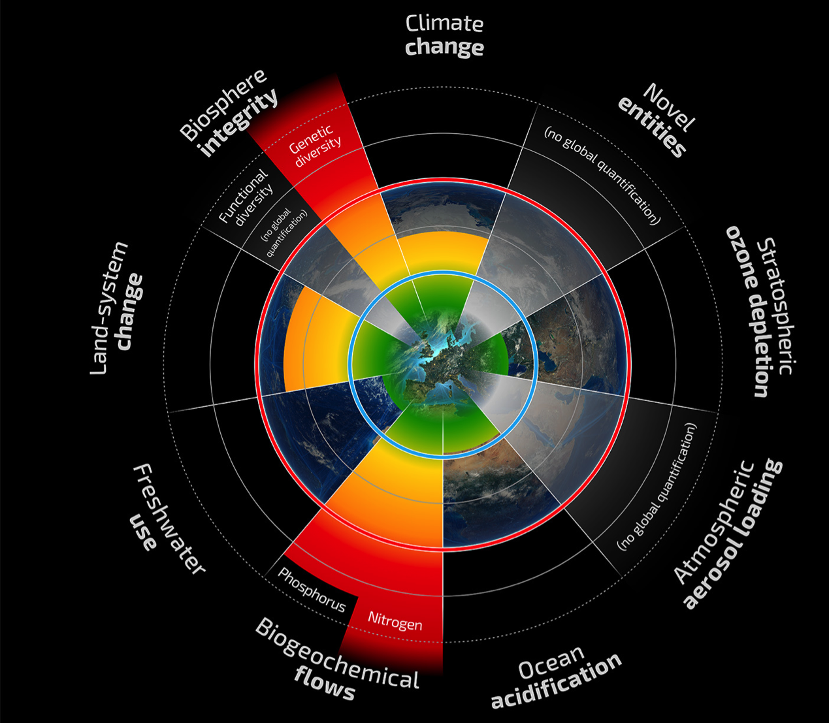
Ex. #2: Novel Entities:
Invasive Pests & Diseases
“Novel entities”: new substances that are invented or introduced by humans; might include chemical pollution, invasive species…
e.g., Dutch Elm Disease & Emerald Ash Borer
Example of introduced pests threatening our urban forest functioning, biodiversity, benefits provided
Notes:
Novel entitties in planetary boundary lingo refers to
We rarely know how novel entities might impact humans or ecosystem health

Slide 38
Ex. #3: Land-Use Change
Development in/around urban areas impacts trees/forests
Decisions during development can help preserve & protect trees
Tree Preservation Ordinances, e.g., Highland Park, IL:
  Tree preservation rate after residential construction 75%
  No relationship between proximity to new foundation & condition or mortality
  Pike, O’Herrin, Klimas, & Vogt (2021), Urban Forestry & Urban Greening

Slide 39
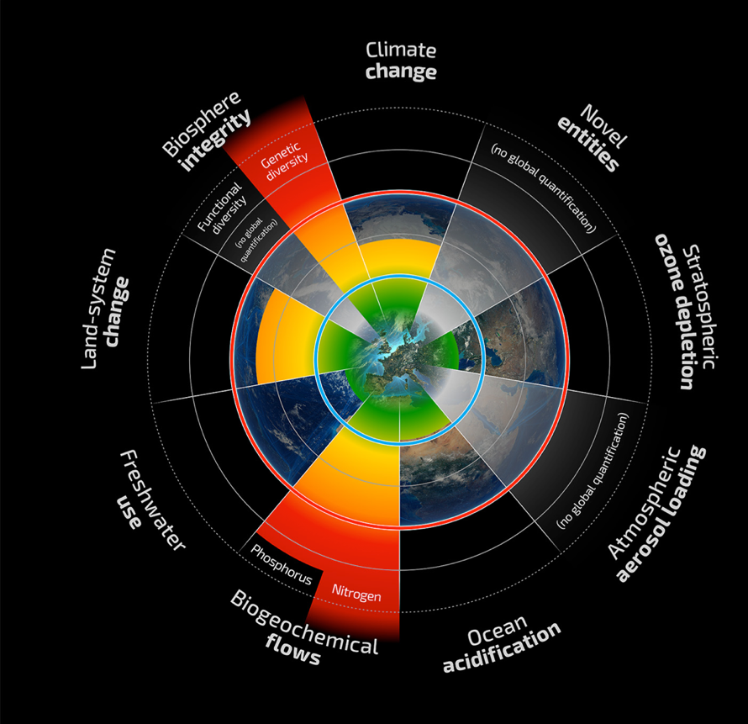
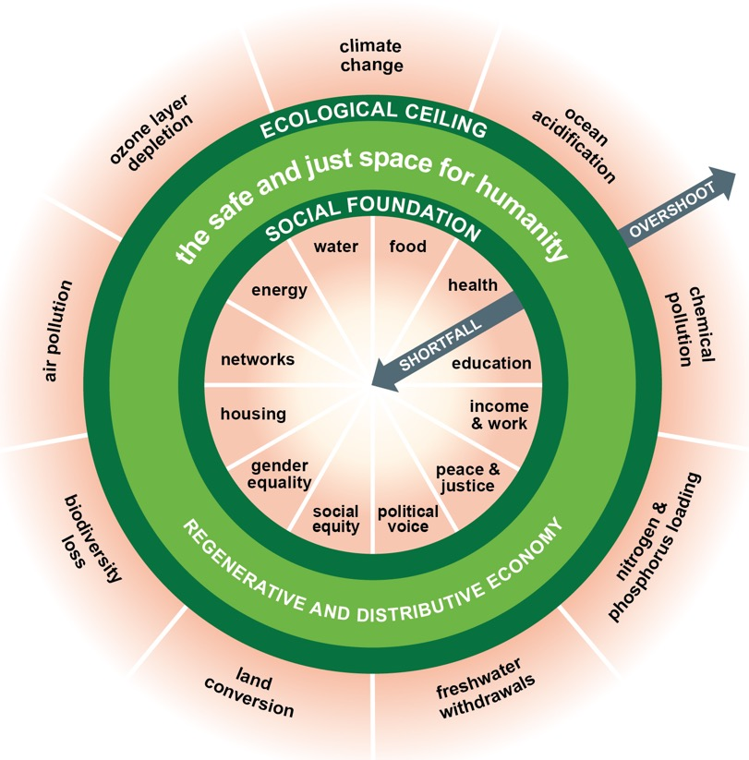

More than Planetary processes
Equity
Environment
Economy
Planetary
Boundaries
https://doughnuteconomics.org

Slide 40
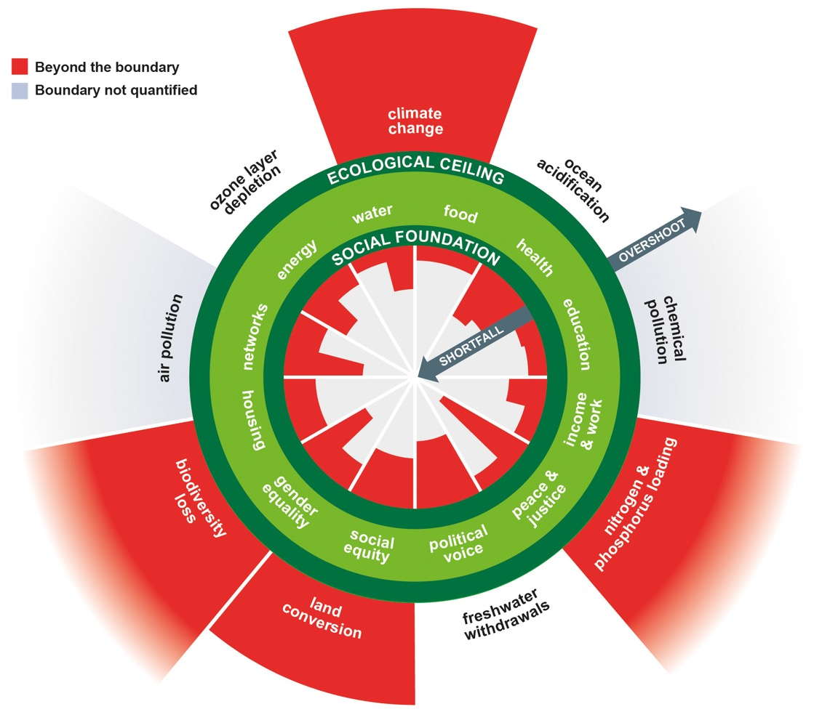
“Doughnut model”
Includes 12 ”social foundations”
A “safe and just space”
Globally, we are currently meeting none of the 12 social needs
Surpassing 4 boundaries

Slide 41

“doughnut model” thinking cultivates Resilience
Urban forests have social and ecological benefits that make cities more livable, empower stronger communities, and so much more…
...energy savings
…green jobs
…fostering conversations about race, gender, equity, equality…

Slide 42
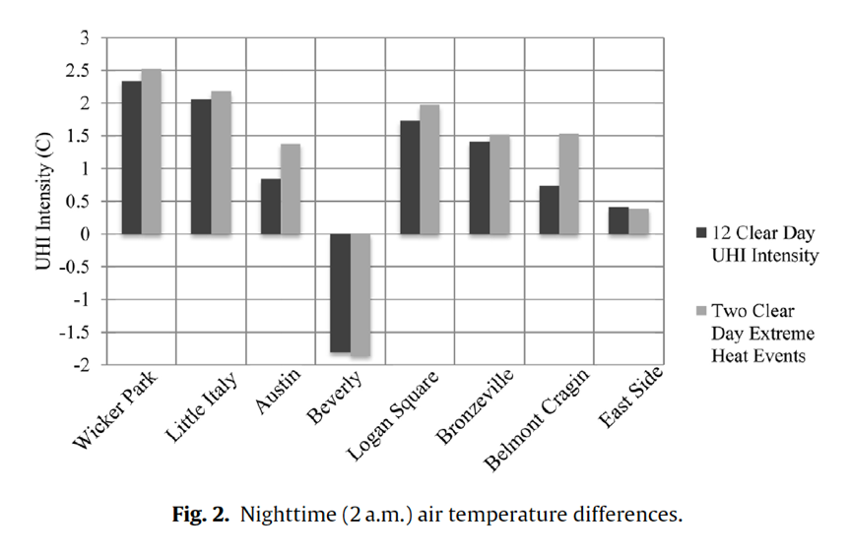
Ex.: Heat Islands & Extreme Heat events
Urban trees help manage extreme heat events
Highest imperv.← →lower imperv.
Coseo & Larsen 2014: tree cover + imperv. surfaces explain 68% of 2 am temp difference
<Prevailing winds enter city in this neighb.
Drawing by J. Vogt
More trees = lower urban heat effects

Slide 43
Applying the General Framework
environmental constraints
For your urban forest:
What are the environmental constraints or limits?
What are the most important social or human needs?
THE CHALLENGE: Managing for multiple constraints and multiple needs simultaneously…
…A WICKED PROBLEM
safe & just space for urban forests
social/human needs
See also:
Vogt, J., & Hauer, R. (2017). Sustainability science for urban foresters and arborists. Arborist News, 26(4), 28–34.
Notes:
The planetary boundaries/social foundations model of a safe and just operating space can be generalized to any system by thinking about the environmental constraints and social or human needs that are critical to system functioning or health.
For your urban forest – what are the environmental constraints that you must be cognizant of in managing yoururban forest? What about social or human needs?

Slide 44


Forest Resource
Community
Support
Management

Slide 45

How can urban foresters and urban forests help our cities live within “safe and just space”?

Slide 46

Thank You!
Jess Vogt
jess.vogt@depaul.edu
www.lufa-depaul.org (slides available here shortly)

Slide 47
Full Citations List
J.R. Clark, N.P. Matheny, G. Cross and V. Wake. (1997). A Model of Urban Forest Sustainability. Journal of Arboriculture 23(1):17-30
Coseo, P., & Larsen, L. (2014). How factors of land use/land cover, building configuration, and adjacent heat sources and sinks explain Urban Heat Islands in Chicago. Landscape and Urban Planning, 125, 117–129. https://doi.org/10.1016/j.landurbplan.2014.02.019
Leach, M., Reyers, B., Bai, X., Brondizio, E. S., Cook, C., Díaz, S., … Subramanian, S. M. (2018). Equity and sustainability in the anthropocene: A social-ecological systems perspective on their intertwined futures. Global Sustainability, 1. https://doi.org/10.1017/sus.2018.12
Raworth, K. (2012). A safe and just space for humanity: Can we live within the doughnut? Retrieved from https://www.oxfam.org/en/research/safe-and-just-space-humanity
Raworth, K. (2017). Doughnut Economics: 7 ways to think like a 21st century economist. White River Junction, Vermont: Chelsea Green Publishing.
Steffen, W., Richardson, K., Rockström, J., Cornell, S., Fetzer, I., Bennett, E., … Sörlin, S. (2015). Planetary Boundaries: Guiding human development on a changing planet. Science, 347(6223), 1259855. https://doi.org/10.1126/science.1259855
Steffen, W., Rockström, J., Richardson, K., Lenton, T. M., Folke, C., Liverman, D., … Schellnhuber, H. J. (2018). Trajectories of the Earth System in the Anthropocene. Proceedings of the National Academy of Sciences, 115(33), 8252–8259. https://doi.org/10.1073/pnas.1810141115
Steffen, W., Broadgate, W., Deutsch, L., Gaffney, O., & Ludwig, C. (2015). The trajectory of the Anthropocene: The Great Acceleration. The Anthropocene Review, 2(1), 81–98. https://doi.org/10.1177/2053019614564785
Vogt, J., & Hauer, R. (2017). Sustainability science for urban foresters and arborists. Arborist News, 26(4), 28–34.

